Slide 1
CULINARY ARTS Registration Night 2023-24 Cohort

Slide 2
AGENDA
-EMCC Admissions /Registration-Explain procedures for registration and begin process today.
-FERPA release forms
-Unique partnership and benefits for the program (completion of Culinary Arts I Certificate)
-Transfer options for Culinary Arts I Certificate
-Disability Resources and Services (DRS)
-Uniforms (fitting, book store information)
-Differences between college programs and high school programs / policies (C or better to earn certification, prerequisites for continuing classes in spring semester)

Slide 3
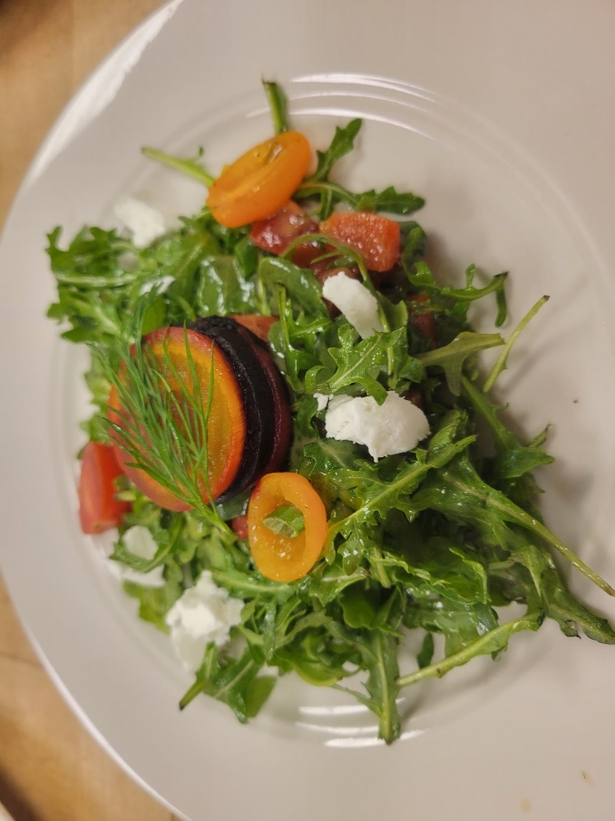
Courses by Semester
EMCC schedule vs. High School Schedule
Monday-Thursday: 1pm-3:45pm
Fall ‘23
CUL113 Commercial Baking (August-October / 8 weeks)
CUL115 Sanitation (August-December / 16 weeks)
CUL105 Principles of Professional Cooking (October-December / 8 weeks)
Spring ‘24
CUL103 Breakfast and Cold Foods (January-March / 8 weeks)
CUL120 Food Costing (January-May /16 weeks)
CUL201 International Cuisine (March-May / 8 weeks)
Students enrolled in the Culinary Arts program must attend class during the dates required. EMCC schedule may not match high school schedules (Fall and Spring Break).

Slide 4
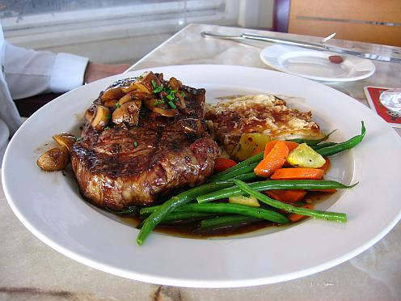
COLLEGE CREDENTIAL
It’s important to note that students enrolled in the Culinary Arts Program are not only enrolled in the West-MEC program, but they are also college students enrolled in a Certificate of Completion Program; earning college credit and starting a college transcript at Estrella Mountain Community College.
Upon successful completion of the program, students will earn the following college credential that can be used for the job market and transferred into the AAS degree program at EMCC:
Certificate of Completion-Culinary Arts I
To earn the Certificate of Completion-Culinary Arts I, students must achieve a grade of C or better in all of their Culinary college classes. This certificate also has several transfer options for students to continue their Culinary education.

Slide 5
Grades and Prerequisites
Students must earn a grade of C or better in all classes to earn the EMCC certificate of completion. Capstone course (CUL213) in this program requires a prerequisite to be successfully completed in the Fall semester.
Fall 23
CUL113 Commercial Baking (August-October)
CUL115 Sanitation (August-December)
CUL105 Principles of Professional Cooking (October-December)
Spring 24
CUL103 Breakfast and Cold Foods (January-March)
CUL120 Food Costing (January-May)
CUL201 International Cuisine (March-May)*
*Requires a prerequisite of CUL105 for enrollment.

Slide 6
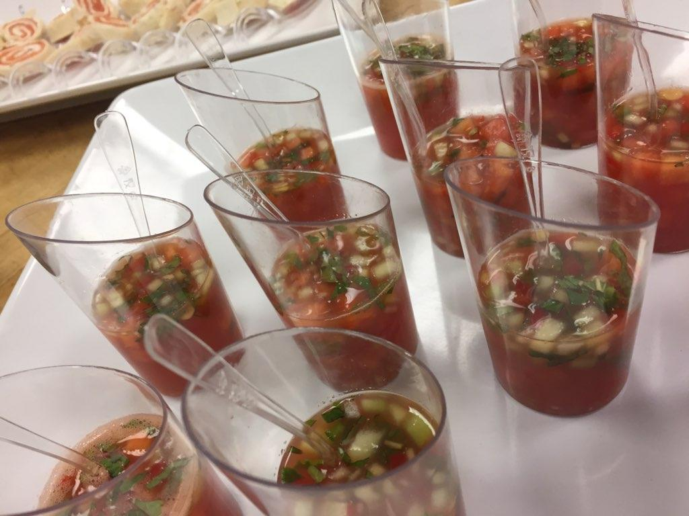
Degree & Career Options
Students can pursue short term programs, part-time and full time, as well as the 2 year AAS in Culinary Arts.
AAS in Culinary Arts (2 years, full time)
60-66 credits, Culinary and General Education Component
Certificate of Completion-Culinary Arts II (3-4 semesters)
36-38 credits
Certificate of Completion-Culinary Arts I (1 to 2 semesters)
16-20 credits
Certificate of Completions-Commercial Baking and Pastry (2 semesters)
18-20 credits

Slide 7
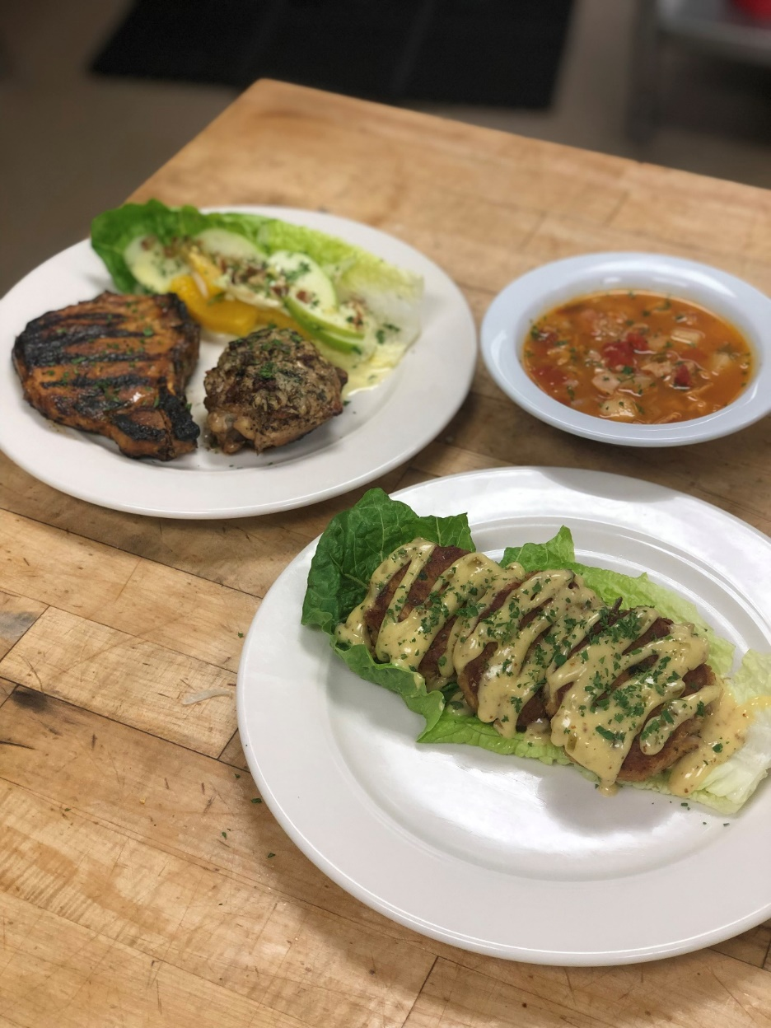
Stackable Credentials / University Transfer
All academic awards within the Culinary Arts program are offered as stackable credentials.
Students can begin with a Certificate of Completion (CCL) in Culinary Arts I, which stacks into CCL Culinary Arts II and the AAS Degree.
Upon successful completion of the AAS Degree, students have the option to transfer into any of the Bachelor degree programs listed below to continue their education:
Bachelor of Hotel and Restaurant Management, NAU
BIS-Hospitality Leadership (90/30), NAU
Bachelor of Applied Science, Foodservice Management, ASU
Bachelor of Hospitality Management, GCU

Slide 8
ServSafe Food Manager Certification
Culinary Arts students are required to successfully complete a ServSafe foodservice sanitation course as part of the certificate and degree programs.
ServSafe is a food and beverage safety training and certificate program administered by the U.S. National Restaurant Association. The program is accredited by ANSI and the Conference for Food Protection.
Successful completers of the exam earn the nationally recognized credential of ServSafe Food Manager.
Food Manager Certification is required by Maricopa County Environmental Services for all managers of a kitchen operation.

Slide 9
Becoming an EMCC College Student
Students enrolled in the West-MEC Culinary Arts program must also enroll separately with EMCC as an official student.
Registration with West-MEC does not automatically enroll a student into the EMCC program.
Dual participation within two programs.
EMCC admissions staff are here this evening to assist with the process.

Slide 10
FERPA Family Educational Rights and Privacy Act
West-MEC students are also EMCC college students.
Because they are college students, confidentiality is protected by FERPA.
Faculty are unable to discuss grade status with parents if issues arise, unless the student signs a FERPA waiver.
To complete a FERPA waiver, please work with admissions / registration personnel.

Slide 11
Disability Resources and Services
Students with an IEP or a
504 Accommodation Plan
Services offered at High School do not automatically carry over to the college program.
Student / Parent must initiate assistance with the
EMCC Community College Disability Coordinator
for intake and potential accommodations.
For more information, please call EMCC at:
(623) 935-8863

Slide 12
Tuition-Please Read
West-MEC pays the EMCC college tuition for in-state students, but the tuition amount will remain on the individual student’s account until fiscal processes are complete between West-MEC and EMCC offices.
A tuition bill may appear on the student’s EMCC account and student center, along with email notification from the college for tuition due.
PLEASE IGNORE THESE MESSAGES AND BALANCE IF THEY APPEAR IN THE STUDENT ACCOUNT AT ANYTIME DURING THE FALL AND SPRING SEMESTER.
All student accounts for the West-MEC Culinary cohort are coded as third party billing, and the student/parent is not responsible for the tuition.

Slide 13
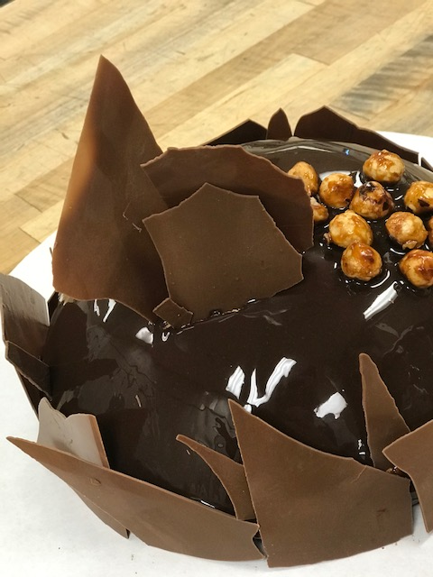
Examples of Food Industry Sectors that Students can focus their Career Goals
Professional Cook / Chef
Private Restaurants
Resorts and Hotels
Cruise Lines
Corporate Cafeterias
Corporate Restaurant Groups
Institutional (Hospitals, Assisted Living, School Lunch Programs)
Catering
Ownership
Consulting
Educator

Slide 14
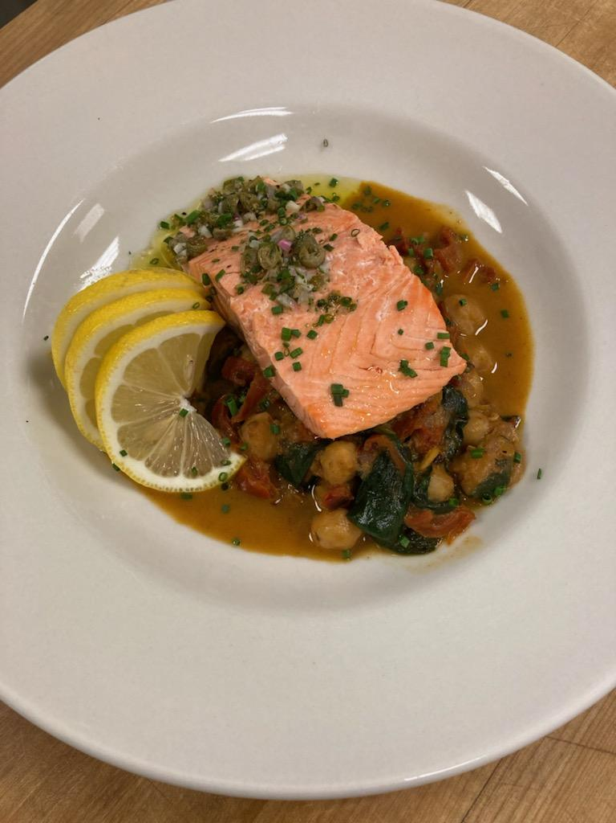
Graduates and Employers Below are examples of where our students have found employment
Abbie Cakes Sweet Kitchen-Baker
Backstreet Asia Restaurant-Chef Owner
Kale Personal Chef Services-Chef Owner
The Wigwam Resort-Cook I
Desert Diamond Casino, Glendale-Baker
Banner Del E. Webb Medical Center-Cook Assistant
Anhelo Restaurant-Chef Owner
Essence Bakery, Phoenix-Baker
State Farm Stadium-Cook
Arizona Biltmore-Cook 1
Chartwells-Campus Foodservice Manager
Tempo Bistro-Line Cook
The Vic Bar and Kitchen-Line Cook
Four Peaks Brewing Company, Phoenix Sky Harbor Airport-Kitchen Manager
J.W. Marriot Hotels-Line Cook
Panera Bread/Paradise Bakery and Café, West Phoenix-Bake Training Specialist
Off the Hook Fish-N-Tacos-Co-Owner
Millennium High School-Teaching Assistant
Oregano’s Pizza Bistro-Front of House Supervisor
The Phoenician-Sous Chef
Brookdale Freedom Plaza-Cook

Slide 15
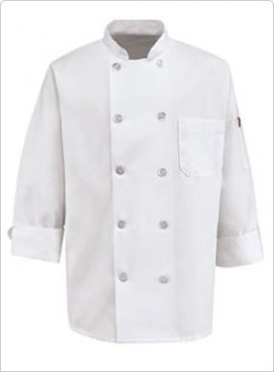
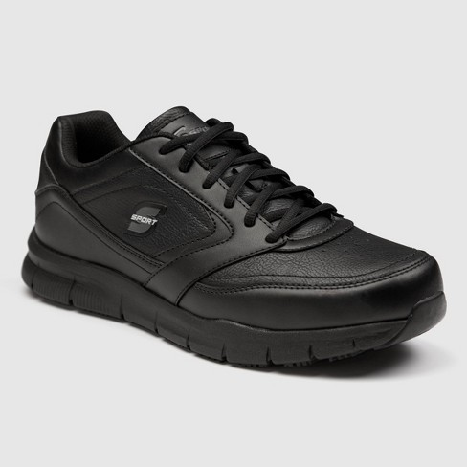
MANDATORY DRESS CODE FOR LAB BASED COURSES
For Culinary Lab Courses, students must follow the uniform guidelines below. Students are not allowed to wear uniforms from an outside business or other organization.
Purchase from EMCC Bookstore:
2 ea Chef Jackets-clean and wrinkle free for class
2 ea Check Pants
2 ea Beanie Hat-hair above shoulders and restrained under hat
2 ea Aprons-clean and wrinkle free for class
Students Purchase on their Own:
White T-Shirts-to be worn under chef jacket
Black shoes, Smooth Surface / Easy Clean, Non-slip, closed toe
Socks that fit above the ankle (for protection from hot liquid spills)

Slide 16
CULINARY ARTS
UNIFORM and TEXTBOOK REQUIREMENTS
For Culinary Arts Courses, students must follow the uniform guidelines below:
Purchase from EMCC Bookstore:
2 ea Chef Jackets-clean and wrinkle free for class
2 ea Check Pants
2 ea Beanie Hat-hair above shoulders and restrained under hat
2 ea Aprons-clean and wrinkle free for class
Students Purchase on their Own:
White T-Shirts-to be worn under chef jacket
Black, Non-slip, closed toe shoes with washable surface
Socks that fit above the ankle (for protection from hot liquid spills)
Sizing directions and pricing for uniforms are on the following pages of this document.
The EMCC bookstore is located inside the Komatke Enrollment Center building. Semester hours vary and can be found on the bookstore website. All textbook and uniform orders can be ordered at the bookstore website, www.shopestrella.com, and shipped to the appropriate address or picked up at your convenience once the order is ready. Shopping in person will allow students to see sizing (they do not have fitting rooms but can exchange sizes with original tags and valid receipt)
If choosing online ordering, there will be an option for in-store pickup or shipping. Ground shipping is $7.99 (expedited shipping is available for overnight shipping at $19.99 but any Maricopa County address should expect to receive the order within five business days.)
For bookstore question or help with online ordering please call 623.935.8875

Slide 17
To place an online order with the EMCC Bookstore, please follow the instructions below:
Go to: www.shopestrella.com (We recommend using Chrome or Safari.)
•Under “Get Your Textbooks” select “Fall 2022” and click “Find Courses”
•On the dropdown menu of “select department” choose “CUL” from the alphabetical list. This will work for any other EMCC courses as well.
•On the dropdown menu of “select course” choose the appropriate course number from the numerical list. On the dropdown menu of “select section” choose the appropriate section number from your course schedule (your course numbers can be found in your EMCC Student Center schedule).
•Repeat this process for all of your courses then hit “find materials for X classes”
•The next page that loads will populate all the corresponding course materials for your courses. You may see many options for textbooks including buying, renting and digital books. You may call the bookstore for assistance/questions on all the options.
*Note: If you are unable to locate the Beanie Hat on the website, please go to the search engine at the top of the page and type: Beanie White
There is a separate course and section called "uniforms and tools" you will see in the dropdown menu under "course number". This is where the uniforms and knife kits are listed. Uniform items have sizing abbreviated with S for small, M for medium, L for large and so on. Jackets and pants do run in unisex sizing (larger one-size-fits-most).
TEXTBOOK REQUIREMENT:
SERVSAFE Coursebook, 8th Edition Paperback, 15 Chapters
ISBN: 978-0-86612-709-7

Slide 18
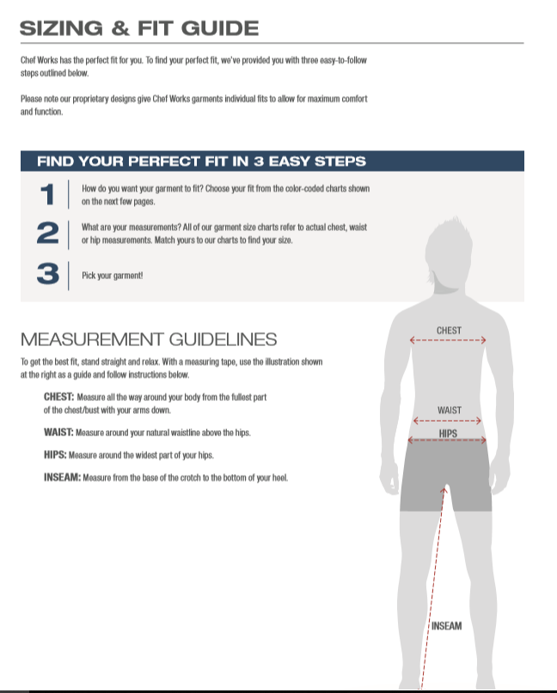

Slide 19
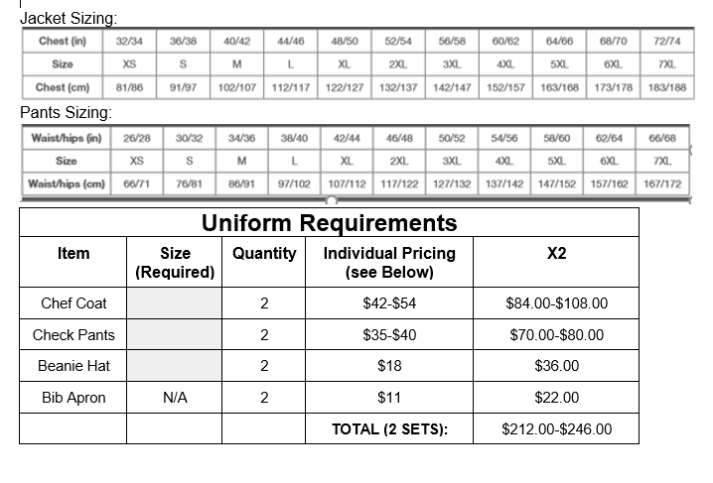

Slide 20
TO DO LIST / QUESTIONS:
Complete registration process with EMCC before high school semester ends (Mid May).
Complete FERPA waiver (optional).
Try on uniforms for proper fit and ordering. Purchase uniforms and textbook by July 31st to ensure delivery before classes begin.
Upon confirmation of registration, and if applicable, contact EMCC DRS services to meet with counselors for questions and proactive academic planning by July 31st.
Attend orientation night on August 8th, 5pm.
Classes being Monday, August 21st.
Questions?

